Slide 1
Human-like AI: Binding Problems and Graph Networks
Group BJL
Boying Li
Jie Zhong
Lianhe Chu 20241216

Slide 2
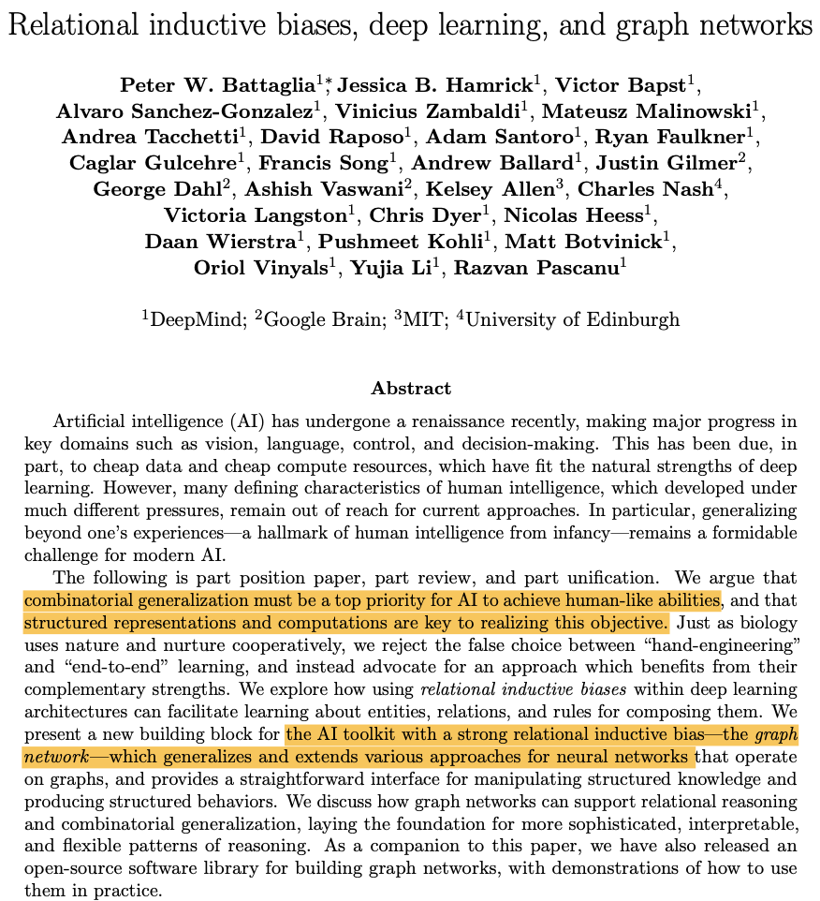
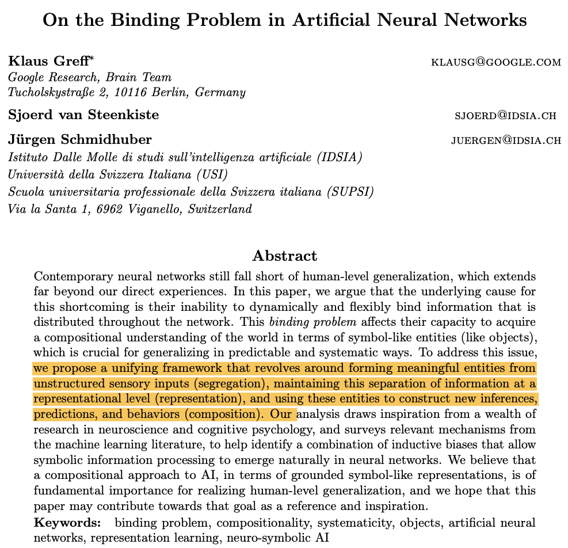
Introduction
Aim to understand two key challenges:
1. The binding problem in neural networks.
2. The role of Graph Networks in relational reasoning.

Slide 3

What is a Binding Problem?
Definition: the challenge of how to dynamically and flexibly combine different pieces of information to form coherent and meaningful representation.
Importance: key points for human-like generalization and symbolic reasoning.
How human perceive the world?
Visual Binding: brain combines visualized features into an integration.
Cross-modal Binding: brain combines scenes and other forms of information such as sound to unify experience.
ANNs face challenges:
Separate information.
Relate features to objects.
Use information dynamically.
Why are there difficulties?
Rely on fixed architectures and weights, unable to adapt dynamically in new situations.
Result in errors when features overlap.

Slide 4
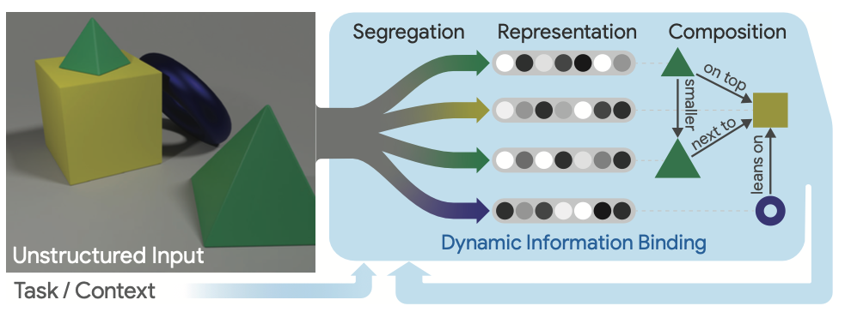
Three key issues in Binding Problems
Representation Problem: concerned with binding together information at a representational level that belongs to separate symbol-like entities.
---- encode non-visual entities such as spoken words, imagined or remembered entities, and abstract entities
such as categories, concepts, behaviors, and goals.
Segregation Problem: about the process of structuring raw sensory information into meaningful entities.
---- enable NNs to acquire an appropriate, context-dependent, notion of objects in a mostly unsupervised fashion.
Composition Problem: about using object representations to dynamically construct compositional models for inference, prediction, and behavior.
---- a neural network thus requires a mechanism that provides the flexibility to quickly restructure its information
flow and ultimately enable it to generalize systematically.

Slide 5
Possible Solutions for Binding
Goals | Solutions
Represent entities and features clearly and preventing from overlapping. | Modular representations.
Allocate specific “slots” for objects to segregate properties dynamically. | Implement slot-based attention or similar architectures.
Dynamically focus on relevant parts of inputs to separate features and relationships. | Use attention mechanisms (self-attention, multi-head attention).
Leverage temporal dynamics to associate and segregate features. | Utilize Recurrent Neural Networks (RNNs), Long Short-Term Memory (LSTM), or Gated Recurrent Units (GRUs) to bind information sequentially.
Maintain relationships between parts and integration in hierarchical structures. | Use capsule networks to encapsulate features into higher-level structures.
Encode features using temporal or spatial dimensions to segregate entities. | Implement temporal coding.
Represent entities as nodes and relationships as edges in a graph. | Leverage graph neural networks (GNNs).
Mimic brain mechanisms for binding features dynamically. | Introduce oscillatory neural networks.
Build architectures designed for relational reasoning. | Use models like Relational Networks or Message-Passing Neural Networks.

Slide 6
Why Relational Reasoning?
Reasons: Limitations of binding emphasize necessities for structured, relational reasoning.
Key definitions:
Relational reasoning: involves manipulating structured representations of entities and relations,
using rules for how they can be composed.
An inductive bias: allows a learning algorithm to prioritize one solution (or interpretation) over another, independent of the observed data.
Structure: the product of composing a set of known building blocks.
An entity is an element with attributes, such as a physical object with a size and mass.
A relation is a property between entities.
A rule is a function (like a non-binary logical predicate) that maps entities and relations to other entities and relations, such as a scale comparison like is entity X large?

Slide 7
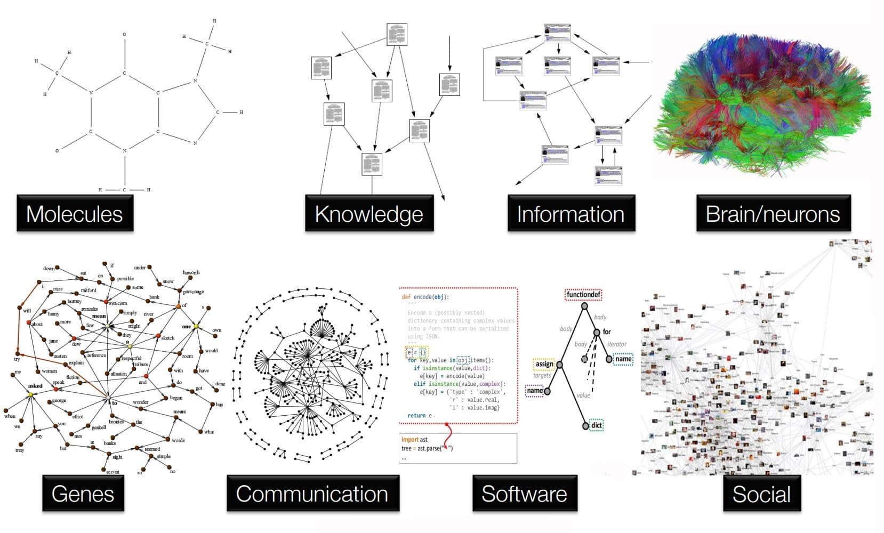
What are Graph Networks?
Graph Networks: a class of functions for relational reasoning over graph-structured representations
Components:
Nodes: Entities (Objects).
Edges: Relationships between entities.
Global Attributes: system-wide properties

Slide 8
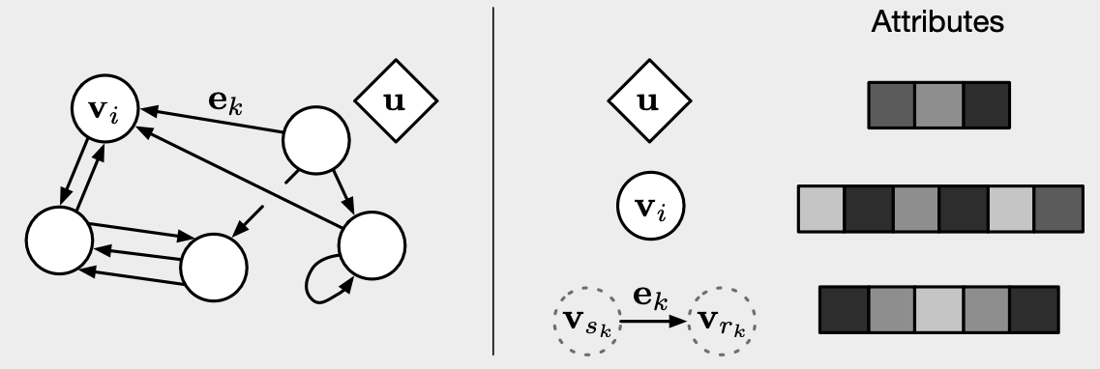
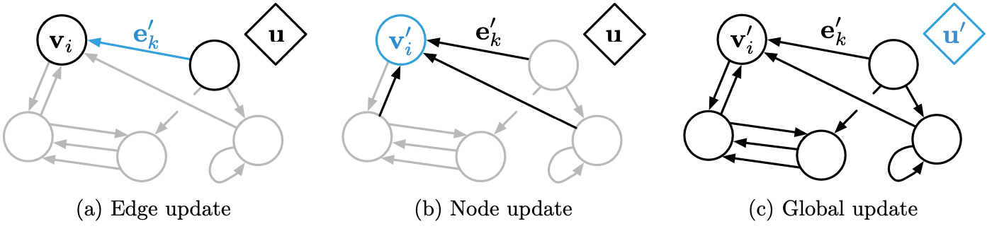
Structure of Graphs
v_{i} : a node.
e_{k} : an edge.
U: the global attributes.
s_{k} and r_{k} : indicate the indices of the sender and receiver nodes, for edge k.
Directed : one-way edges, from a “sender” node to a “receiver” node. Attribute : properties that can be encoded as a vector, set, or even another graph.
Attributed : edges and vertices have attributes associated with them. Global attribute : a graph-level attribute. Multi-graph : there can be more than one edge between vertices, including self-edges.

Slide 9
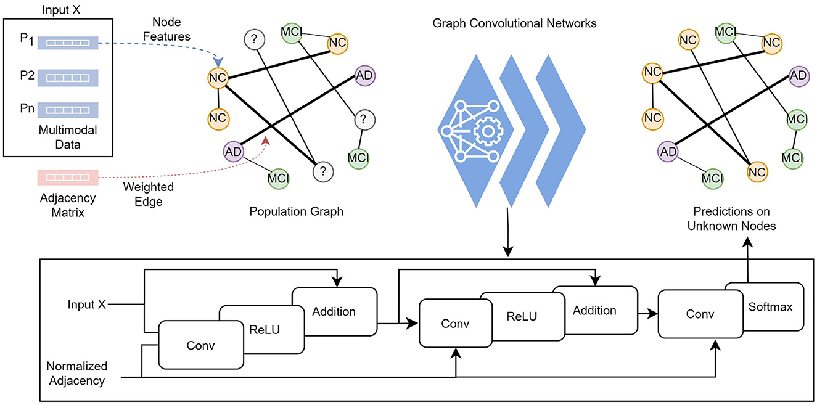
Advantages of Graph Networks
Dynamic Flexibility:
Adapt to various relationships between entities.
Function in dynamic environments.
Hierarchical Reasoning:
Reasoning on both local and global level relationships.
Enable compositional thinking.
Improved Interpretability:
Relationships between data clear.
Scalability:
Able to handle large-scale data.
Suitable for specifical domains analysis.
Combinatorial Generalization:
Can build new inferences and predictions.

Slide 10
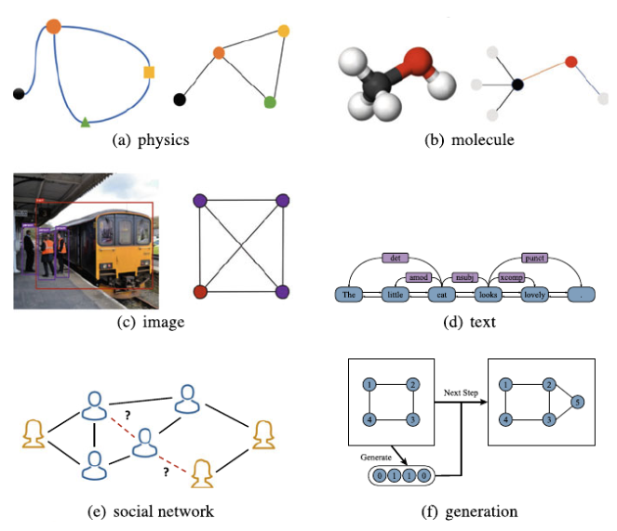
Applications of Graph Networks
Physics: Predicting gesture language, body motion.
Medical sciences: chemical interactions, designing new drugs.
Vision: autonomous driving, robotics.
Social Networks: interactions between users, predicting community trends, and identifying influencers.
Knowledge Graphs: searching engines, building recommendation systems.
Infrastructure: transportation systems, and communication networks.

Slide 11
Summary
Limitations of Binding Problems hinder neural network generalization and symbolic reasoning.
Graph Networks enable flexible frameworks for representing and relational reasoning over structured data.
Graph Networks have diverse applications across various fields.
Dynamic binding and Graph Networks will definitely enhance AI’s power in generalization and adaption in complicated situations.
Future direction:
Hybrid models combining various solutions such as applying both binding
solutions and graph networks.
More application exploration in real-world problems.

Slide 12
Questions?

Slide 13
References
https://blogs.nvidia.com/blog/what-are-graph-neural-networks/
https://www.frontiersin.org/journals/artificial-intelligence/articles/10.3389/frai.2023.1334613/full
https://www.researchgate.net/publication/342679866_Network_Representation

Slide 14

Attendees list

